Slide 1


Few-shot Classification for Fraud Detection
SIC – AI800
Notes:
1.7.2013
Note:
1
‹#›

Slide 2
Agenda
    Team Members
    Problem Statement
    Targeted audience
    Data Insights & Fraud Patterns
    Modeling & Evaluation
    Deployment
    Future Enhancements
    Business Value
Samsung Innovation Campus

Slide 3
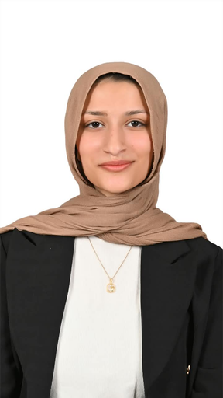
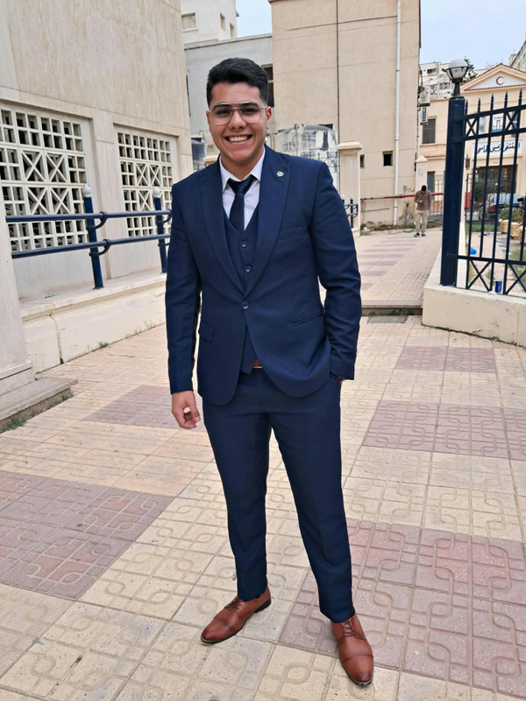
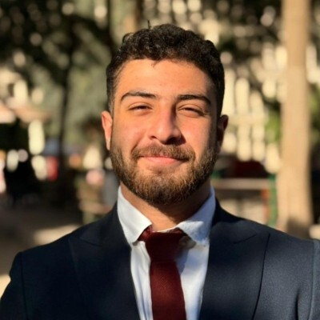
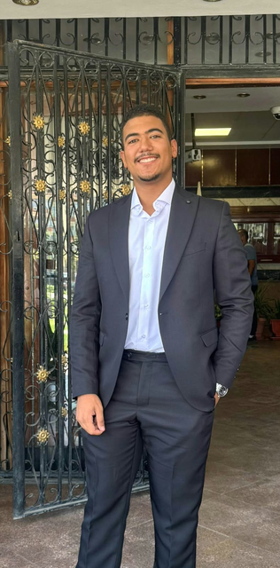
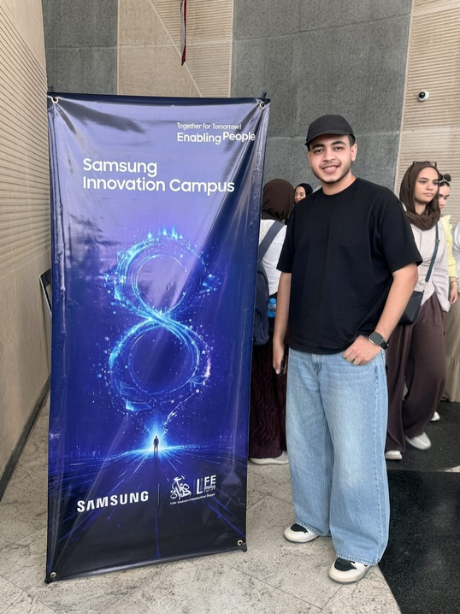

Team Members
Menna
Josam
Abdullah
Omar
Mohamed
Samsung Innovation Campus

Slide 4

Problem Statement
Samsung Innovation Campus
Notes:
1.7.2013
Note:
2
‹#›

Slide 5

Problem Statement
Credit card fraud accounts for less than 1% of transactions and constantly evolves, making traditional classifiers less effective at detecting emerging fraud patterns. This project aims to develop and evaluate an anomaly-detection model that learns normal transaction behavior to identify suspicious deviations in highly imbalanced data, maximizing fraud detection while minimizing false positives.
Samsung Innovation Campus

Slide 6
Targeted audience
Samsung Innovation Campus
Notes:
1.7.2013
Note:
2
‹#›

Slide 7


Targeted audience
Samsung Innovation Campus

Slide 8
Data Insights & Fraud Patterns
Samsung Innovation Campus
Notes:
1.7.2013
Note:
2
‹#›

Slide 9
About Dataset
Key Insight: The dataset tracks 983 unique cards over an extended timeline (1,300 transactions per card), establishing a deep behavioral history for each customer
Transaction Period
Total Transactions
Features
2019
1.8M+
23
Spans a continuous 24-month period, accurately simulating real-world seasonal shifts and long-term customer spending patterns
A massive scale of 1.85+ million transactions, exhibiting extreme class imbalance with less than 1% fraudulent cases
Consists of categorical and numerical variables detailing transaction characteristics, temporal attributes, and merchant profiles
Samsung Innovation Campus

Slide 10

Data Insights
Genuine
Imbalanced Dataset
1,289,169
The dataset comprises over 1.8 million credit card transactions. Within this dataset, fraudulent transactions constitute less than 1% (0.58%) of the total volume, indicating an extreme class imbalance.
Fraud
7,506
Samsung Innovation Campus

Slide 11
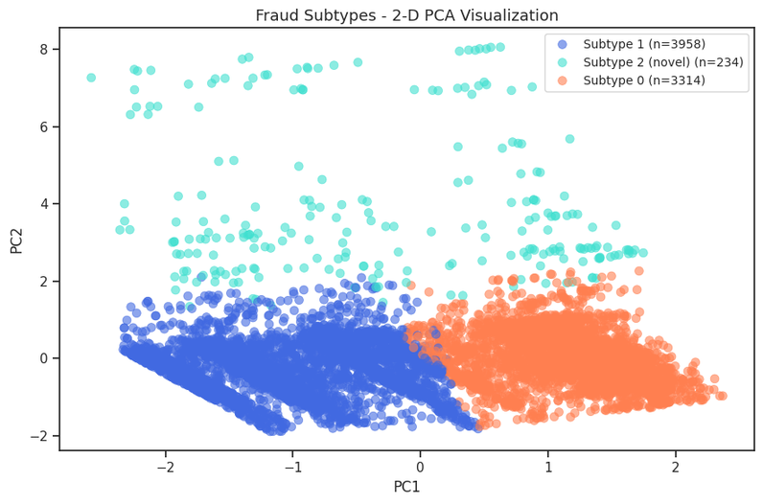
Exploring Fraud Patterns
Subtype 1
Represents recurring, high-frequency fraud tactics that follow predictable patterns
Subtype 2
Captures rare, non-traditional fraud strategies successfully isolated by anomaly detection
Subtype 0
Exhibits distinct behavioral characteristics and alternative execution methods
Samsung Innovation Campus

Slide 12
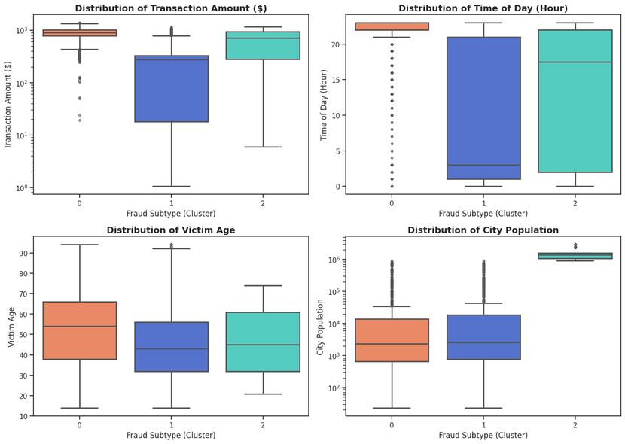
Fraud Transactions Differ
Key Insight
Cluster 0 targets high-magnitude financial transactions, whereas Cluster 1 specializes in low-to-medium dispersed transactions
Cluster 0 operations exclusively cluster around midnight, demonstrating a distinct nocturnal behavioral pattern
Cluster 2 concentrates strictly within high-density metropolitan areas exceeding one million inhabitants
Fraud vectors remain persistent annually, executing sophisticated behavioral alignment to bypass automated threshold detection.
Samsung Innovation Campus

Slide 13
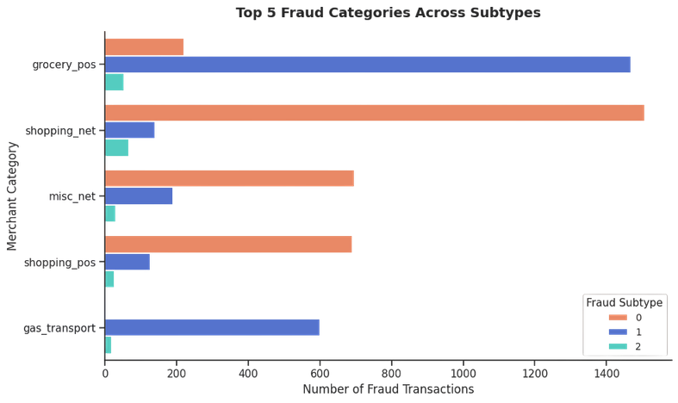
Business Value
Where Are We Losing the Most
Online shopping represents the highest vulnerability point, directing our focus to maximize recall in this high-risk zone to prevent severe financial losses
Samsung Innovation Campus

Slide 14
Modeling and Evaluation
Samsung Innovation Campus
Notes:
1.7.2013
Note:
2
‹#›

Slide 15




Preprocessing
Preprocessing Pipeline
Main Dataset
Kaggle · Temporal evaluation
Temporal feature engineering
First 10 months
Final 2 months
Extract hour, day, and week from transaction timestamps.
Training
Testing
Categorical encoding
Convert categorical features into model-compatible representations.
Support Dataset
Mendeley · Few-shot evaluation
Numerical scaling
3 known patterns
5 labeled examples
Scale numerical features to prepare model inputs.
Initial training
From the held-out pattern
Samsung Innovation Campus

Slide 16
Supervised Base models
Models Evaluated
Reference for Comparison
1. Logistic Regression
These models establish how conventional supervised learning performs across both experimental settings.
A linear classification baseline for distinguishing fraudulent from legitimate transactions.
2. Random Forest
An ensemble of decision trees that captures nonlinear relationships and feature interactions.
Limitation to Investigate
Can conventional classifiers recognize a previously unseen fraud pattern when given only a few labeled examples?
3. XGBoost
A gradient-boosted tree ensemble that builds successive trees to improve predictive performance.
Samsung Innovation Campus

Slide 17
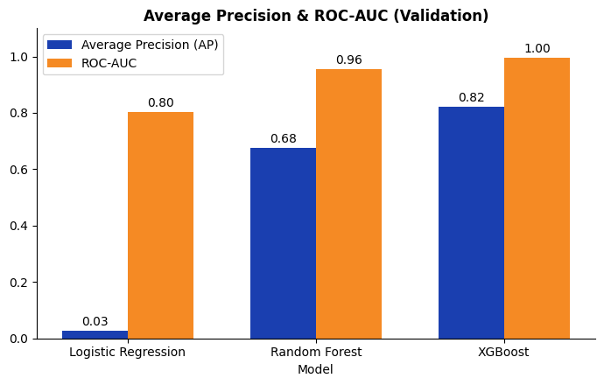
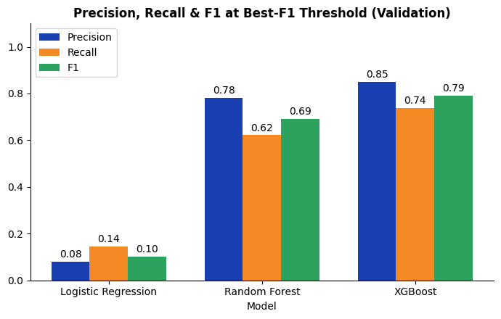

Supervised Base models metrics
Validation Metrics
Average Precision & ROC-AUC (Validation)
Precision, Recall & F1 at Best-F1 Threshold (Validation)
Key Takeaway
What We Observed
Similar ROC-AUC scores can conceal substantial differences in precision–recall performance.
  XGBoost achieved the highest ROC-AUC (1.0) and average precision (0.82).
  Random forest was close behind in average precision (0.68).
  Logistic Regression had a similar ROC-AUC (0.8) but substantially lower average precision (0.03).
Reference for Comparison
These models establish the conventional supervised-learning baseline for our fraud detection experiments.
Samsung Innovation Campus

Slide 18
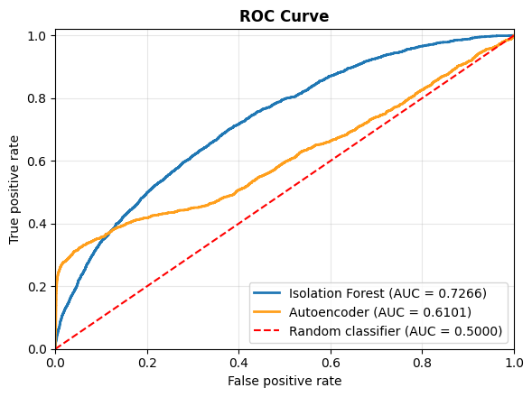
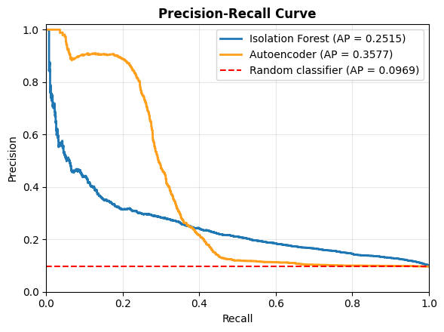
Anomaly Detection
Model | Accuracy | Precision | Recall | F1-Score
Isolation Forest | 87.8% | 32% | 22% | 0.26%
Auto Encoder | 89.6% | 45% | 41% | 45%
Samsung Innovation Campus

Slide 19
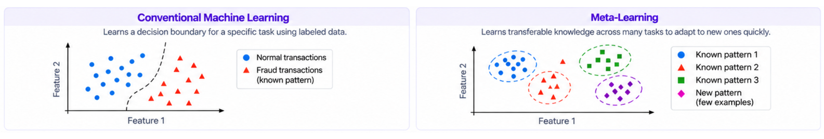
Why Meta Learning
Conventional learning
What is meta-learning?
Why it helps fraud detection
Trains on labeled examples to find a decision boundary for known patterns.
“Learning to learn”
A model acquires knowledge from many tasks, so it can adapt quickly to a new task from a few examples.
  New patterns emerge with very few labels.
  Labeling large datasets for each pattern is costly.
  Adapting from few examples helps catch unseen fraud.
The dilemma
A new pattern appears with only a few labeled examples.
Intuition: conventional learning vs. meta-learning
Samsung Innovation Campus

Slide 20




TabPFN 3.5
How it works
Labeled examples
Receives a small set of transactions with known labels.
In-context learning
Uses the examples as context to make predictions without conventional task-specific fitting.
Predictions
Classifies new transactions based on the supplied context.
Why we chose it
Its in-context learning approach makes it a candidate for testing whether a model can recognize a new fraud pattern from only a handful of labeled examples.
Samsung Innovation Campus

Slide 21
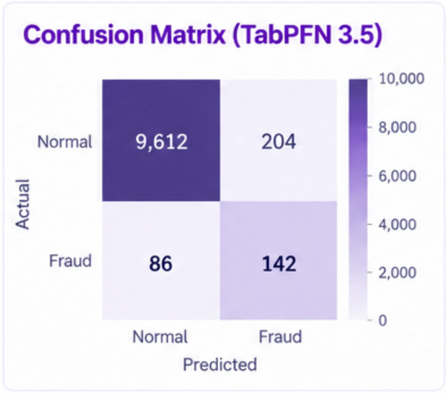
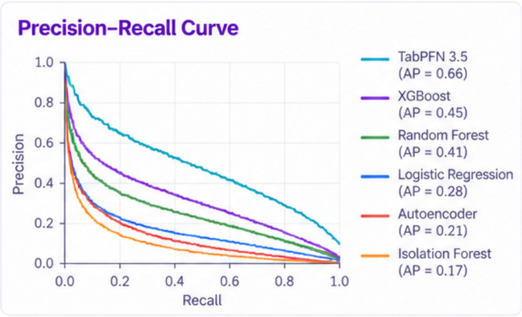
Results on yearly dataset
Model | Accuracy | Precision | Recall | F1-Score
Logistic Regression | 92.84 | 65.3 | 55.71 | 60.13
Random Forest | 95.85 | 78 | 62 | 68
XGBoost | 95.62 | 85 | 74 | 75
Isolation Forest | 87.82 | 31.58 | 22.05 | 25.97
Autoencoder | 90.2 | 49.28 | 41.21 | 44.88
TabPFN 5-shot | 94.31 | 66.76 | 82.19 | 73.67
TabPFN 10-shot | 95.79 | 74.14 | 86.76 | 79.96
TabPFN 35-shot | 96.17 | 75.18 | 90.26 | 82.03
Samsung Innovation Campus

Slide 22
Results on Multi-Pattern dataset
Model | Setting | Best F1 | AP | ROC-AUC
XGBoost | Seen pattern | 0.905 | 0.889 | 0.97
XGBoost | Seen pattern + 5 unseen | 0.903 | 0.913 | 0.98
XGBoost | unseen pattern 0-shot | 0.037 | 0.009 | 0.983
XGBoost | unseen pattern 5-shot | 0.207 | 0.087 | 0.999
TabPFN 3.5 | unseen pattern 5-shot | 0.90 | 0.66 | 0.967
Key takeaways
1
XGBoost performed best on the main dataset, with strong results on future transactions.
2
TabPFN 3.5 outperformed other models on the support dataset.
3
Classical classifiers and anomaly detection were limited with very few labels.
Future Work
  Evaluate on additional real-world datasets.
  Test stronger few-shot and meta-learning methods.
  Explore TabPFN combined with anomaly detection.
  Analyze interpretability (e.g., SHAP, LIME).
Limitations
  Two datasets only; real-world generalization is not guaranteed.
  Results depend on the few labeled examples available.
  Anomaly detection showed higher false positive rates.
  More testing is needed across fraud patterns and periods.
Samsung Innovation Campus

Slide 23
Deployment
Samsung Innovation Campus
Notes:
1.7.2013
Note:
2
‹#›

Slide 24
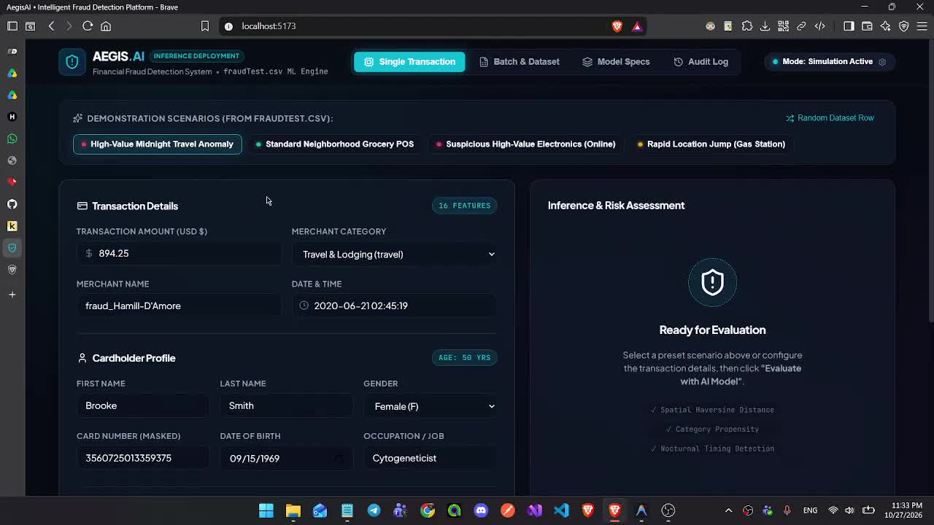
Deployment
Samsung Innovation Campus

Slide 25
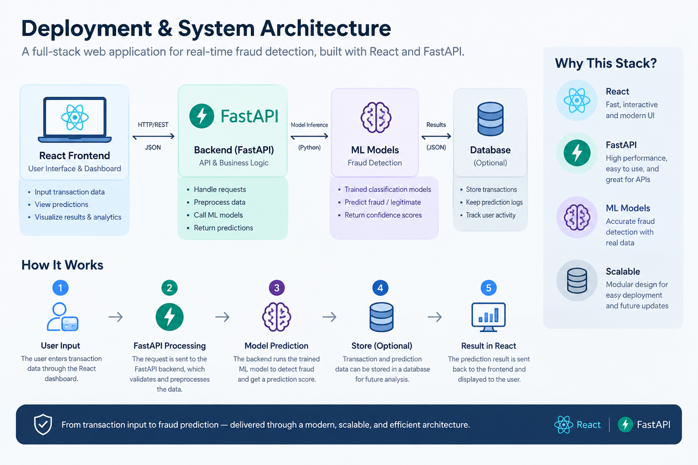
Samsung Innovation Campus

Slide 26
Limitations & Business Value
Samsung Innovation Campus
Notes:
1.7.2013
Note:
2
‹#›

Slide 27

Limitations & Challenges
Limited Labeled Data: Newly emerging fraud patterns may have only a few labeled examples available.
Data Limitations: Public datasets may not contain reliable labels for different fraud subtypes, making it difficult to evaluate generalization to truly unseen fraud patterns.
False Positives: Incorrect fraud alerts may increase the workload of fraud analysts and delay legitimate transactions.
Class Imbalance: Fraudulent transactions are typically much less common than legitimate transactions,creating challenges for model evaluation.
Real-World Validation: Performance on simulated few-shot tasks may not fully reflect real-world fraud detection effectiveness.
Privacy & Security: Financial transaction data must be handled securely and in accordance with applicable privacy requirements.
Samsung Innovation Campus

Slide 28
Business Value — Faster Adaptation to Emerging Fraud
Adapt to new fraud patterns using a small number of labeled examples, potentially reducing data-labeling effort.
Reduced Labeling Requirements
Help financial institutions respond to emerging fraud patterns without waiting for a complete model retraining cycle.
Faster Response
Improved Fraud Detection Potential
Support the identification of suspicious transactions associated with newly emerging patterns.
Operational Efficiency
Prioritize suspicious transactions so fraud analysts can focus their attention on potentially high-risk cases.
Provide an approach that banks, payment processors, and fintech companies can evaluate for their fraud detection workflows.
Scalability Potential
Samsung Innovation Campus

Slide 29

ⓒ2020 SAMSUNG. All rights reserved.
Samsung Electronics Corporate Citizenship Office holds the copyright of book.
This book is a literary property protected by copyright law so reprint and reproduction without permission are prohibited.
To use this book other than the curriculum of Samsung innovation Campus or to use the entire or part of this book, you must receive written consent from copyright holder.

Slide 30
Notes:
1.7.2013
14
‹#›

